Slide 1
House Price Analysis in King County, Washington
Jordana Tepper

Slide 2
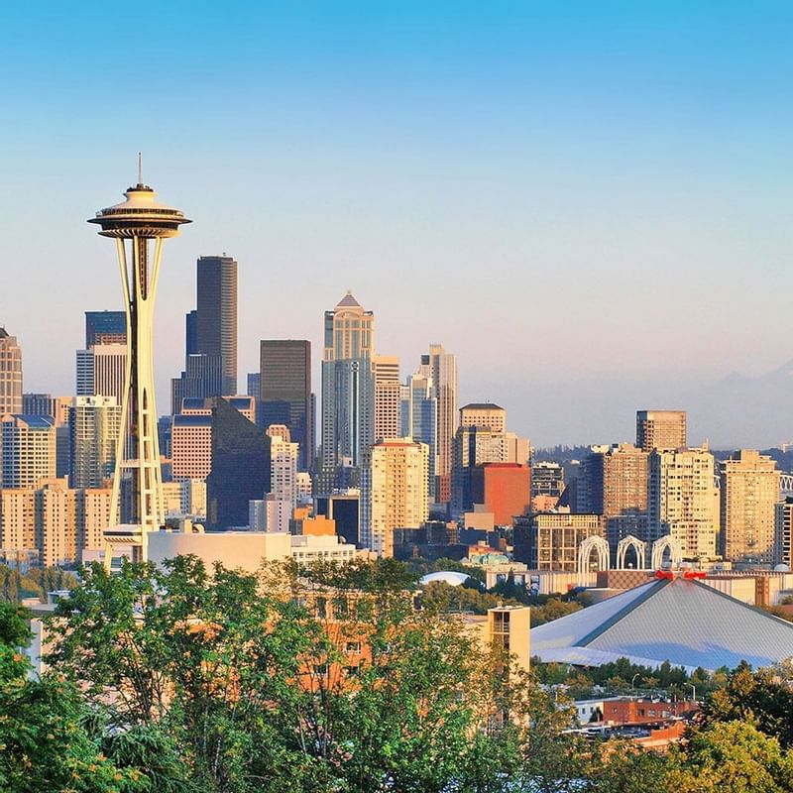
Outline
• Business Understanding
• Data
• Modeling
• Regression Results
• Recommendations
• Next Steps

Slide 3


Congratulations!
You’re grandparents!

Slide 4

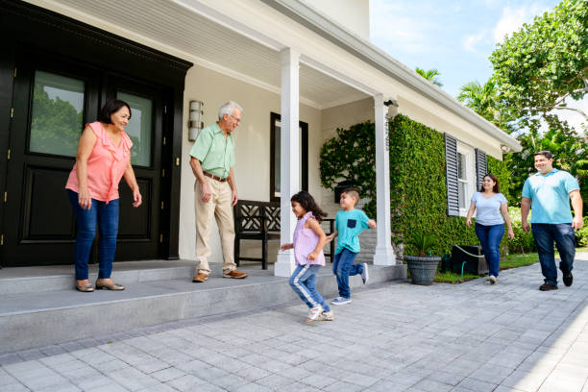
Business Understanding
Budget: $250000
Floors: 1
Square Feet of House: 2000 SF
Square Feet of Lot: 6000 SF
Bedrooms: 3
Bath: 2
Basement?: No
Condition (0-4): Good (3)
Grade (0-7): Good (4)
View Quality (0-4): None (0)
Preferred Month of Purchase: March
Waterfront?: No
Renovated?: No
Year Built: No year in particular
Square Feet of Neighbors’ Houses: No specific square footage
Square Feet of Neighbors’ Houses Lots: No specific square footage

Slide 5
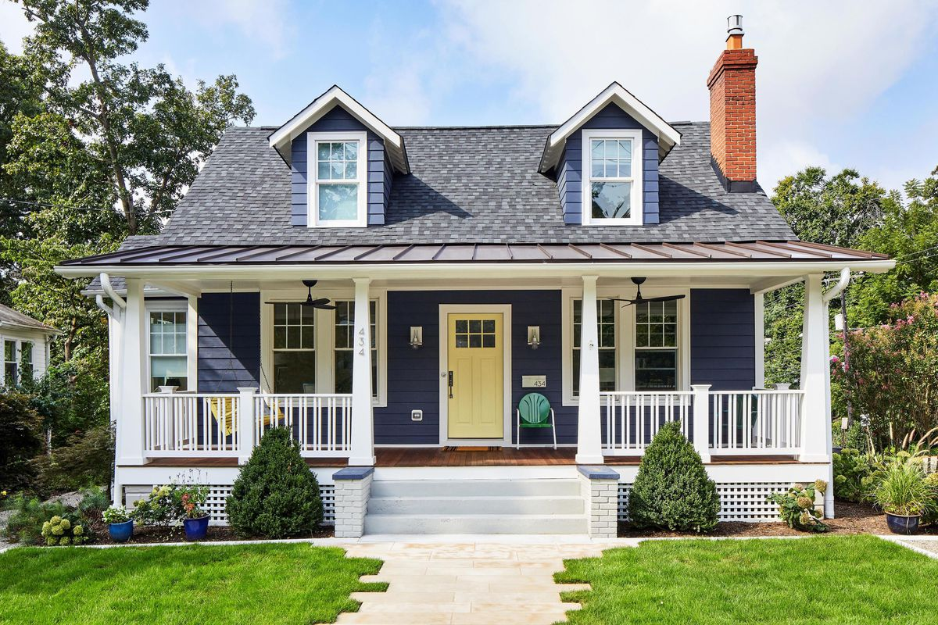
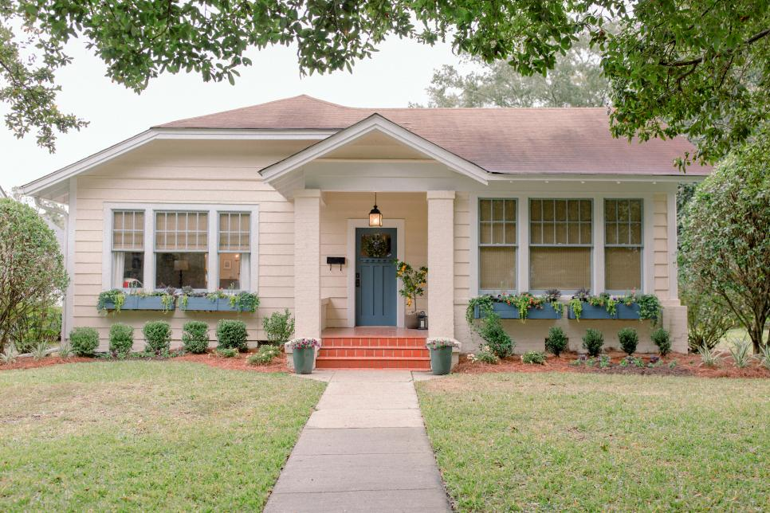
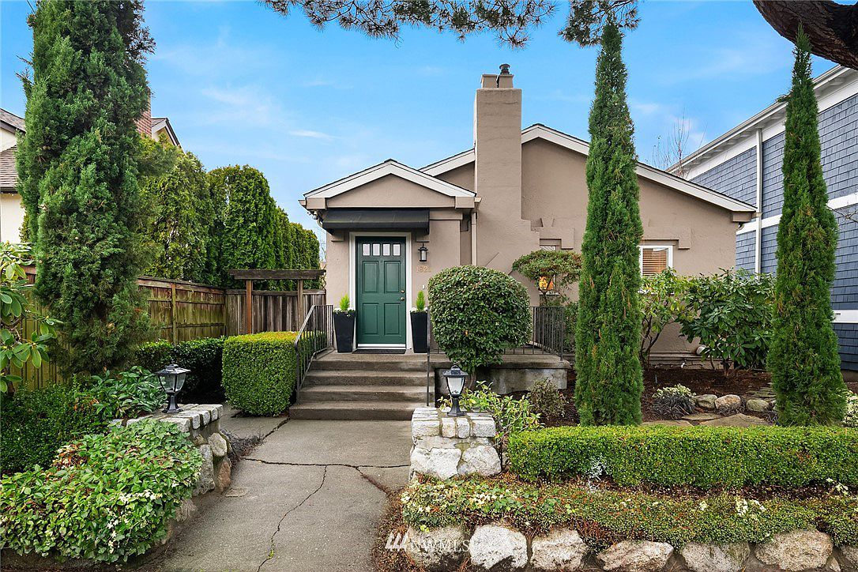
Data
King County, Washington house sales from 2014 to 2015 (Source: Kaggle)
Includes data such as square footage, number of bedrooms, number of bathrooms, zip code, number of floors, condition of the house, and quality of view.

Slide 6
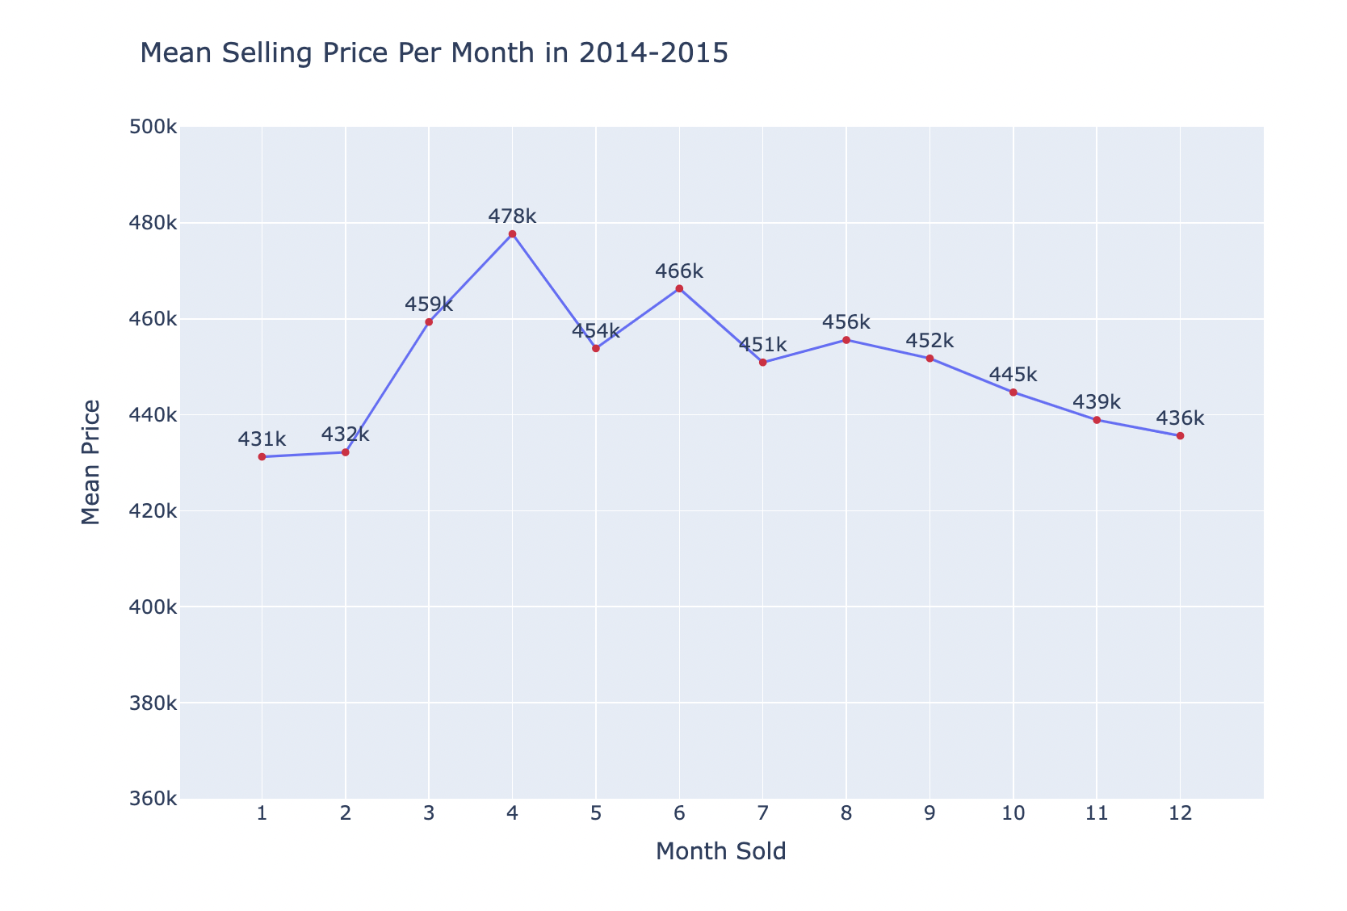
Average Price Per Month

Slide 7
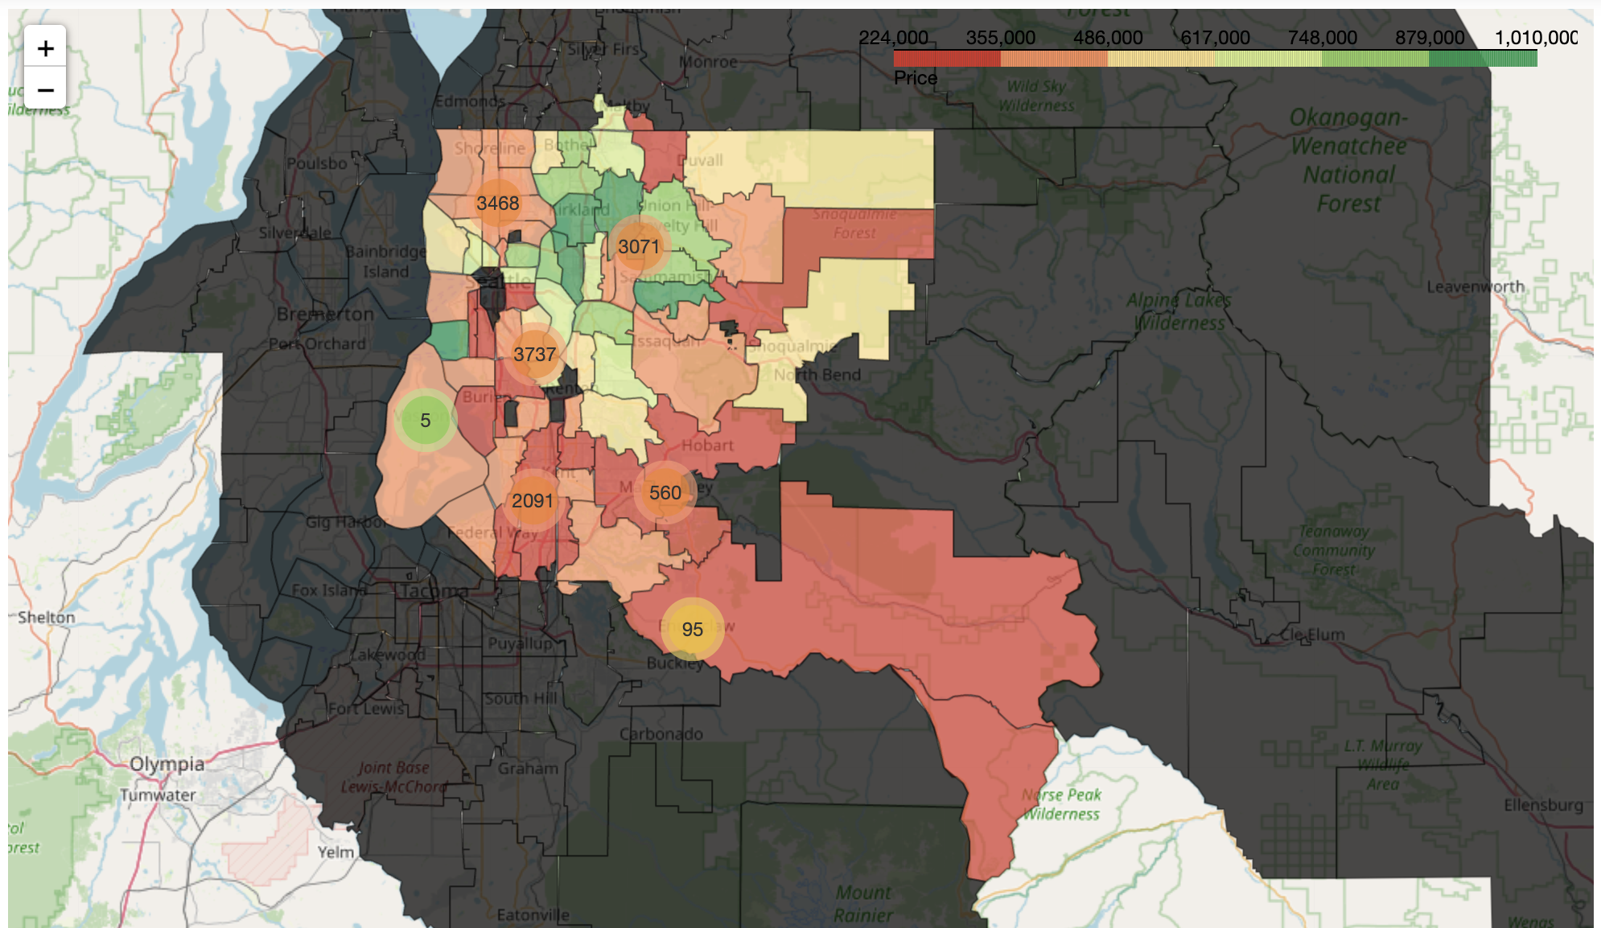
Interactive Map of Zip Codes and Prices
*Viewable in the Project 2 Jupyter notebook on my Github

Slide 8
Modeling
Linear regression
Process:
Made categorical columns more interpretable (ex: date, zip code, condition)
Check for predictors with the strongest and weakest impacts on price
Looked at relationships between predictors
Consistently checked my error

Slide 9
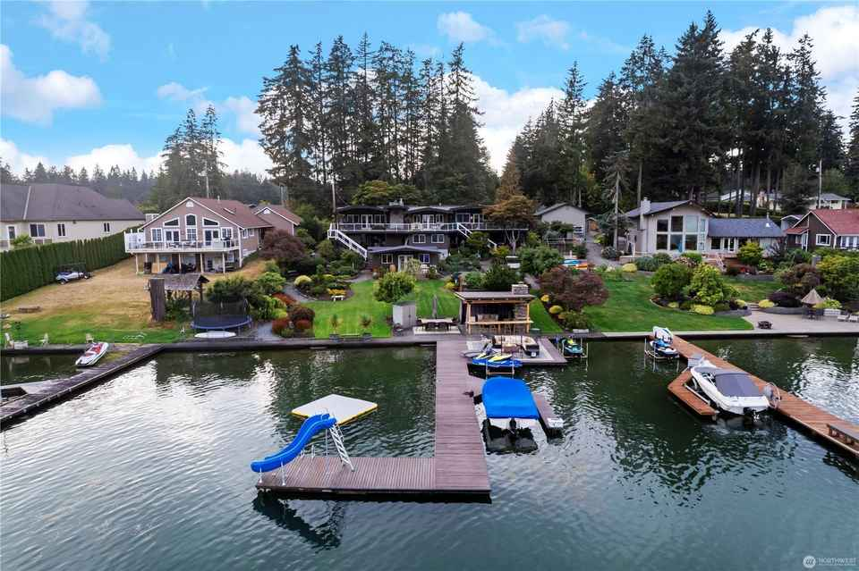
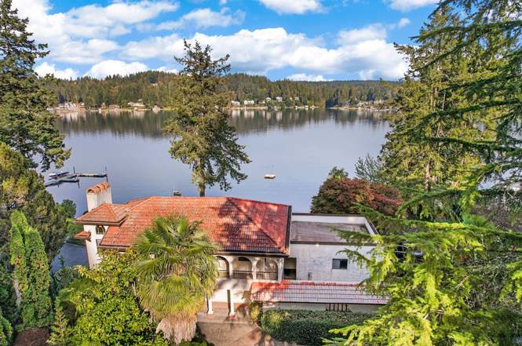
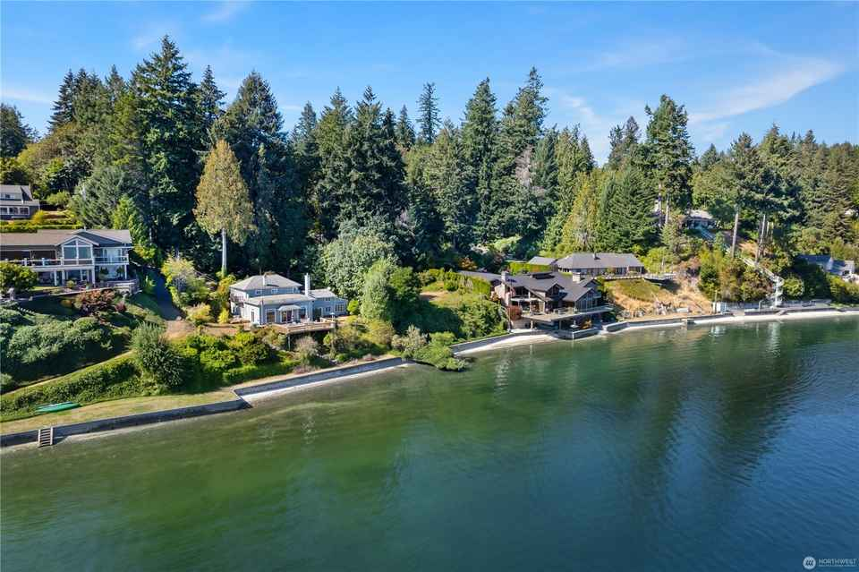
Regression Results
Captures 85.51% of the spread of the data
Error: $52423
Factors that have a large impact on price: Waterfront and Coordinates
Notes:
Compared to houses that are not on a waterfront, we see an associated increase of about 67.37% in price for houses that are on a waterfront.
Essentially, the Northwest in King County is the most expensive and the Southeast in the least expensive

Slide 10
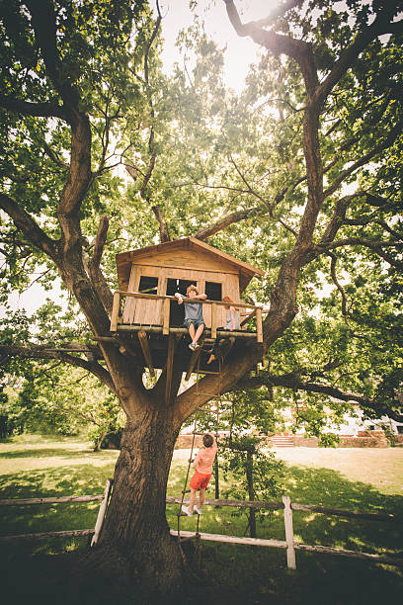
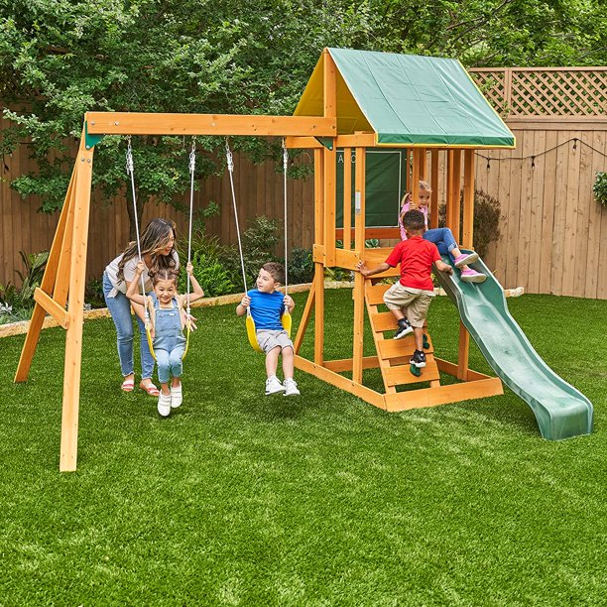
Recommendations
Zip code 98002: $181,858
Zip code 98032: $182,296
Zip code 98168: $195,324
In the case that you save money,
what can you buy?
Notes:
I found the zip codes in King County who had an average house sale price of 250000 or less to see what a home with your criteria would cost in the selected zip codes
While all of these prices are still under $250,000 when adding the average error, the safest decision would be to aim for a house in the zip code 98002 as it has the lowest predicted price. Furthermore, if the stakeholders decide to pursue a house in the zip code 98002 and indeed end up paying less than their budget, they can use the rest of the money in their budget to purchase a swing set for their grandchildren.
Swing set: prices range from the low hundreds to the low thousands depending on size and features
Treehouse: Average national price is $7,350

Slide 11

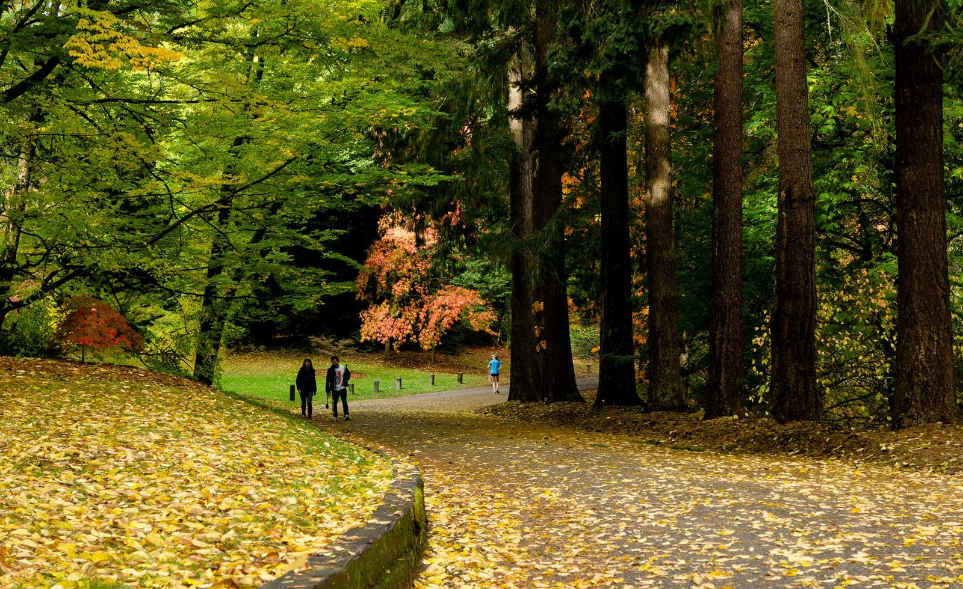
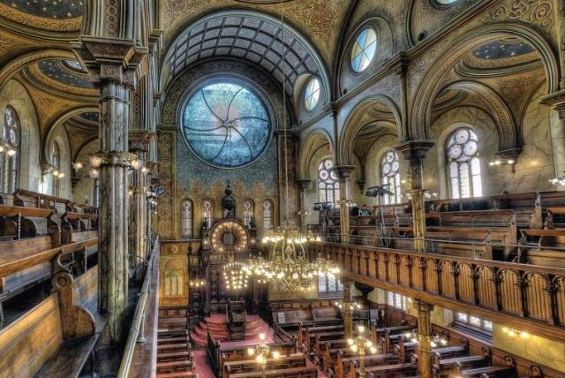
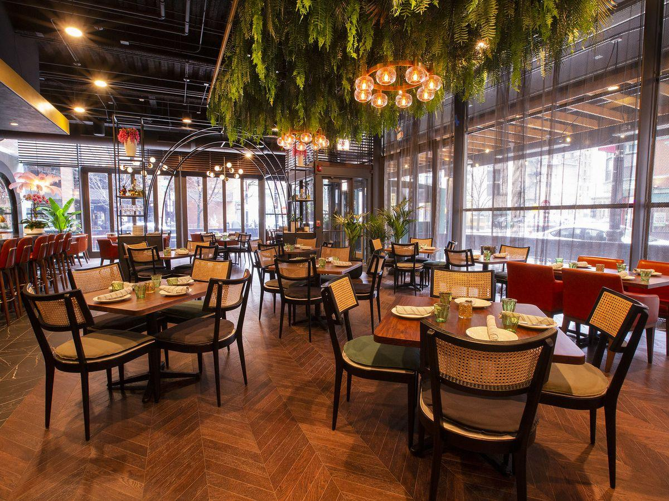
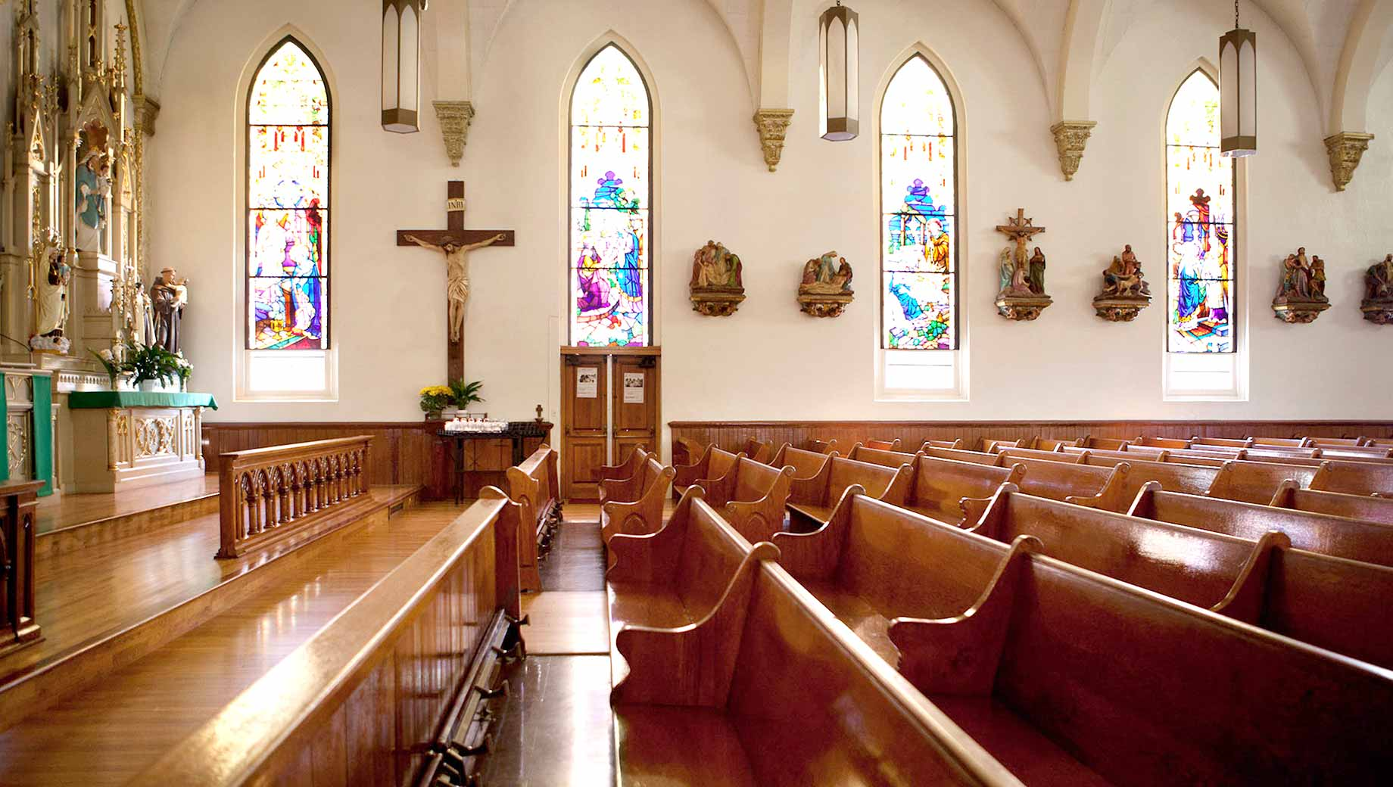
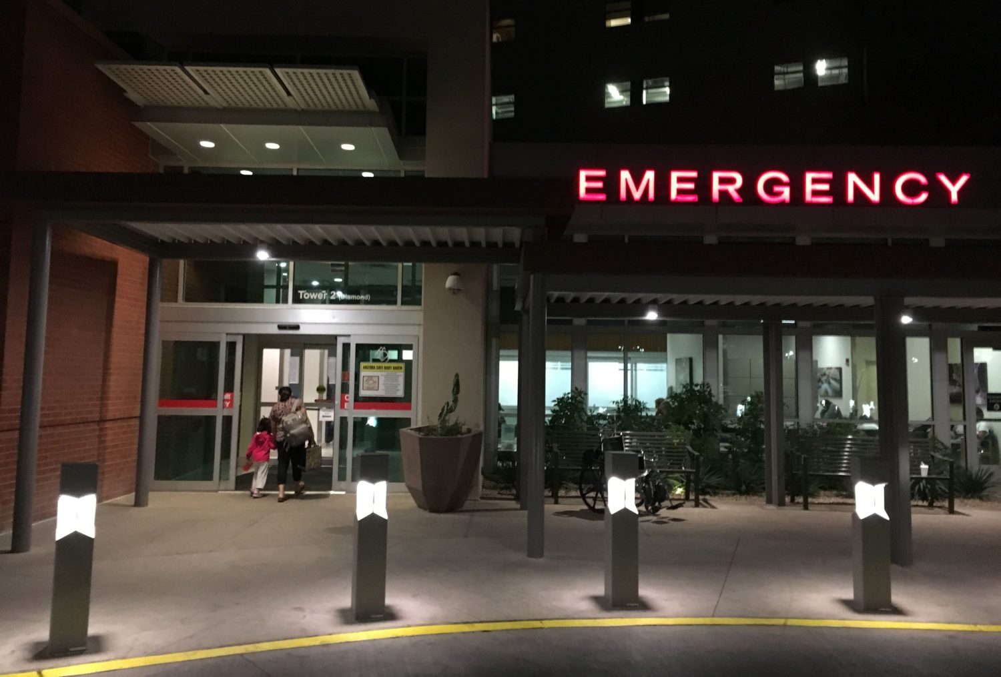
Next Steps
Parks?
Restaurants?
Hospitals?
Synagogues?
Churches?
Mosques?

Slide 12
Thank you!
Email: jtepper724@gmail.com
GitHub: @jordanate
LinkedIn: linkedin.com/in/jordana-tepper

